Slide 1
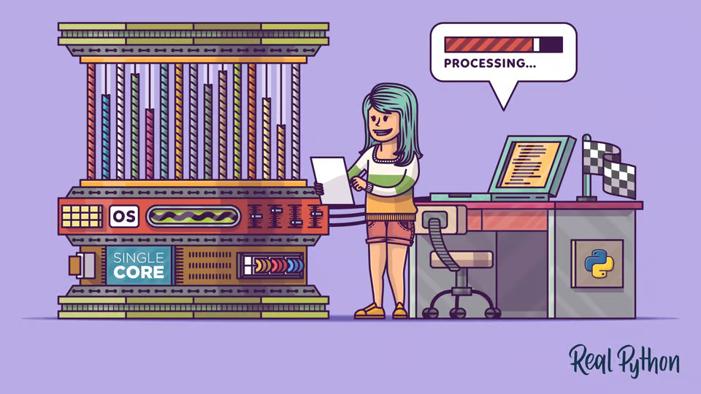

Багатопоточність у Python

Slide 2
You are not making your computer faster
You're pushing the hardware to its limits.

Slide 3

Kahoot Time!

Slide 4
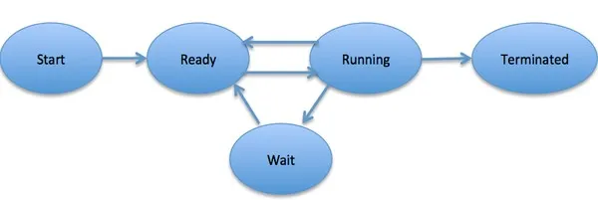
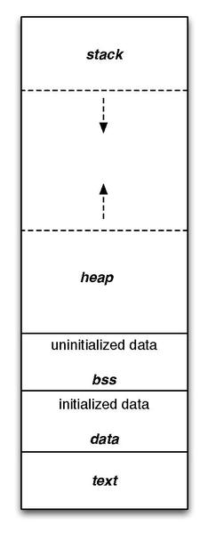
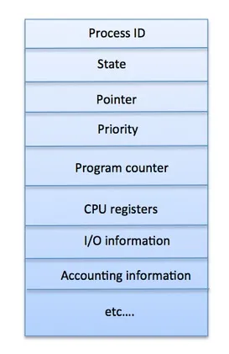
Process

Slide 5
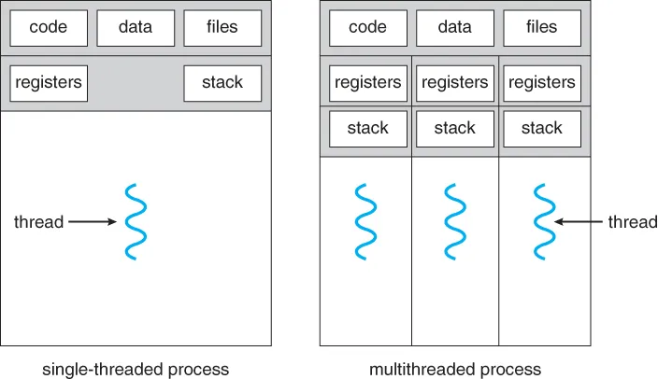
Threads

Slide 6
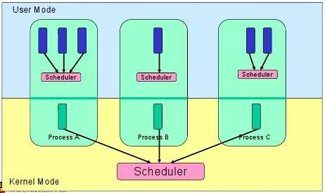
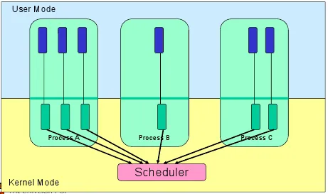
Threads

Slide 7

CPU/IO bound tasks

Slide 8
GIL(Global Interpreter Lock)

Slide 9
Thread creation
Class
Functor
Function
Timer

Slide 10
Access control
Lock
RLock
Semaphore
Condition
Event
Barrier

Slide 11
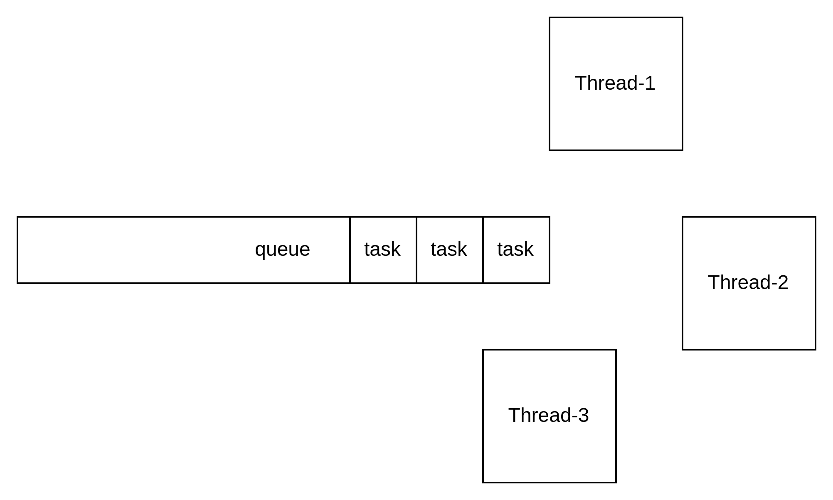
Thread Pull

Slide 12

Дякую

